Slide 1
Notes: 1. Correct fonts won’t load until you open this in PowerPoint (e.g., if you’re previewing this in your browser it’ll look uglier than it actually is). 2. Generate QR codes here: https://www.qrcode-monkey.com/

Slide 2
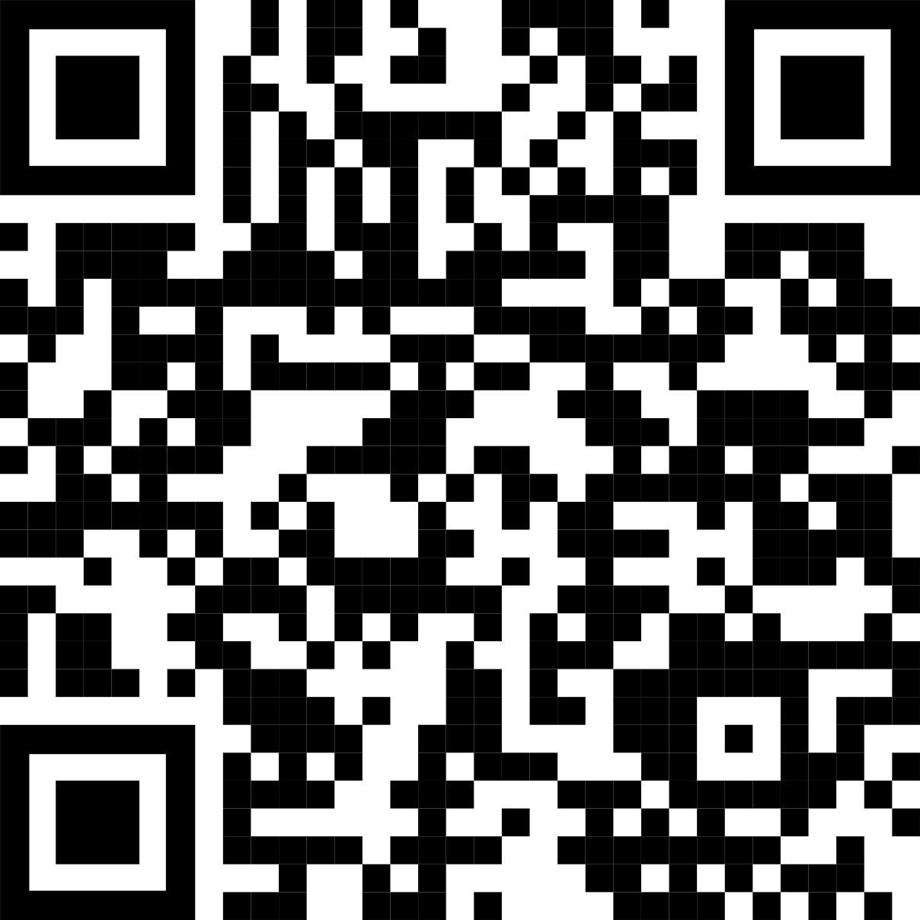

Main summary goes here, translated into plain English. Emphasize the important words.
Non-Cognitive Predictors of Student Success: A Predictive Validity Comparison Between Domestic and International Students
Non-Cognitive Predictors of Student Success: A Predictive Validity Comparison Between Domestic and International Students
FWK/LIBRARY: Leeroy Jenkins
Framework/Library Name Category
Keep font size as high above 28+ as possible.
Keep your summary tight. Think of it like a 5-sec commercial pitch.
The more content you add here, the more cognitive load you add, and the more you’ll turn people off engaging.
Less content = more readers.
Add your project logo, if you have one.
Now delete this text box. ☺
INTRO:
Who cares? Explain why your framework or library was created, and why you decided that one, or more, of the existing frameworks or libraries did not work. Avoid marketing hype words
CONSIDERATIONS
What other frameworks or libraries exist?
How long, what size, and other pertinent data about your framework or library.
How you tested it.
OUTPUT
The essential screen image, graph or code images(s) only.
Keep this to the essential. No more than two (2), and they must be your most influential two (2). Put everything else in Ammo Bar, if needed.
DISCUSSION
“I encountered <code challenge A>, and I looked around for solutions. I was not able to find an acceptable solution, because of <a>, <b>, and <c>.”
Leeroy Jenkins, contributor2, contributor3, contributor4, contributor5, contributor6, contributor7
AMMO BAR
Delete this and replace it with your…
Extra Graphs
Extra Screen Shots
Extra Code Samples
Extra Demo Samples
This section is for the authors to talk about other stuff they think might be important. It might or might not, but it is additional ammo for swaying decisions.
Take a picture to learn more and download the full framework/library.
Notes:
Notes:
In PowerPoint, click View > Guides
Keep text within gutter guides.
Contributor list: Don’t split names onto two lines (e.g., “Jimmy [break] Smith”). If that happens, use a new line, unless you need the space. Bold the first names of anybody who’s presenting in person at the conference.
Intro/methods/result: Do not drop below font size 28, but if you have extra space, jack up the font size until the space is full.
Do not use color in the sidebars except in graphs/figures. It’ll pull attention from the center and slow interpretation for passersby.

